Slide 1
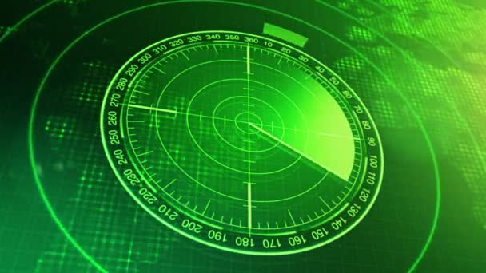
RADAR SYSTEM
KEERTHANA B A
MEGHANA S

Slide 2

INTRODUCTION
Radar was developed as a method of detecting enemy aircraft in World War 2.
Along with the developments in technology over time radar sensors have been used in various sectors
In this project we are going to design an Arduino radar project using Ultrasonic Sensor for detection. An Arduino micro servo motor makes electronics more discipline.

Slide 3
GOAL AND OBJECTIVE
Object-detection system uses radio waves to determine:
RANGE
ALTITUDE
DIRECTION
SPEED OF OBJECTS.

Slide 4
HOW DOES RADAR AND ULTRASONIC SENSOR
WORK?

Slide 5
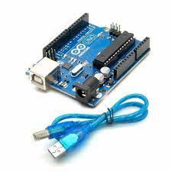
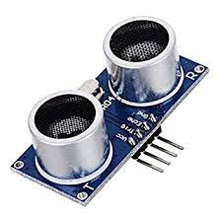
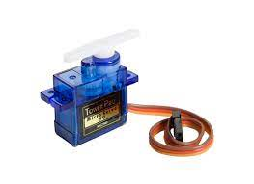
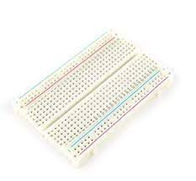
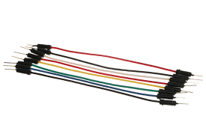
HARD WARE REQUIREMENTS
Arduino Uno
Ultrasonic Sensor
Micro Servo 9g
Bread Board
Jumper Cables

Slide 6
CODE
// Includes the Servo library
#include <Servo.h>.
// Defines Tirg and Echo pins of the Ultrasonic Sensorconst
int trigPin = 10;
const int echoPin = 11;
// Variables for the duration and the distance
long duration;
int distance;
Servo myServo; // Creates a servo object for controlling the servo motor
void setup() {
pinMode(trigPin, OUTPUT); // Sets the trigPin as an Output
pinMode(echoPin, INPUT); // Sets the echoPin as an Input
Serial.begin(9600);
myServo.attach(12); // Defines on which pin is the servo motor attached
}void loop() {
// rotates the servo motor from 15 to 165 degrees
for(int i=15;i<=165;i++){
myServo.write(i);
delay(30);
distance = calculateDistance();// Calls a function for calculating the distance measured by the Ultrasonic sensor for each degree

Slide 7
Serial.print(i); // Sends the current degree into the Serial Port
Serial.print(","); // Sends addition character right next to the previous value needed later in the Processing IDE for indexing Serial.print(distance); // Sends the distance value into the Serial Port
Serial.print("."); // Sends addition character right next to the previous value needed later in the Processing IDE for indexing }
// Repeats the previous lines from 165 to 15 degrees
for(int i=165;i>15;i--){
myServo.write(i);
delay(30);
distance = calculateDistance();
Serial.print(i);
Serial.print(",");
Serial.print(distance);
Serial.print(".");
}}// Function for calculating the distance measured by the Ultrasonic sensor
int calculateDistance(){
digitalWrite(trigPin, LOW);
delayMicroseconds(2); // Sets the trigPin on HIGH state for 10 micro seconds
digitalWrite(trigPin, HIGH);
delayMicroseconds(10);
digitalWrite(trigPin, LOW);
duration = pulseIn(echoPin, HIGH); // Reads the echoPin, returns the sound wave travel time in microseconds
distance= duration*0.034/2;
return distance;}

Slide 8
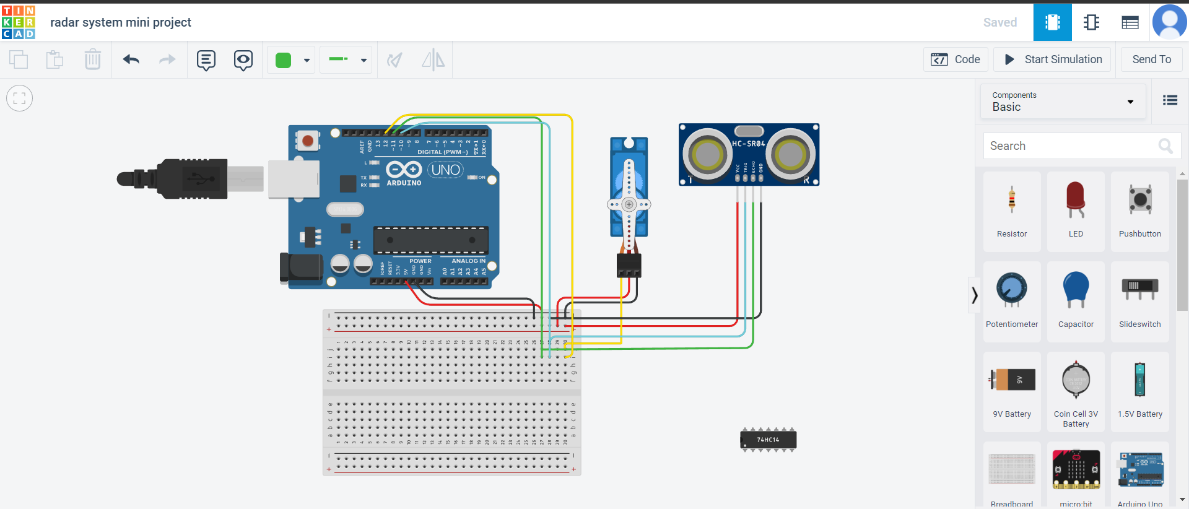
CIRCUIT AND SIMULATION

Slide 9
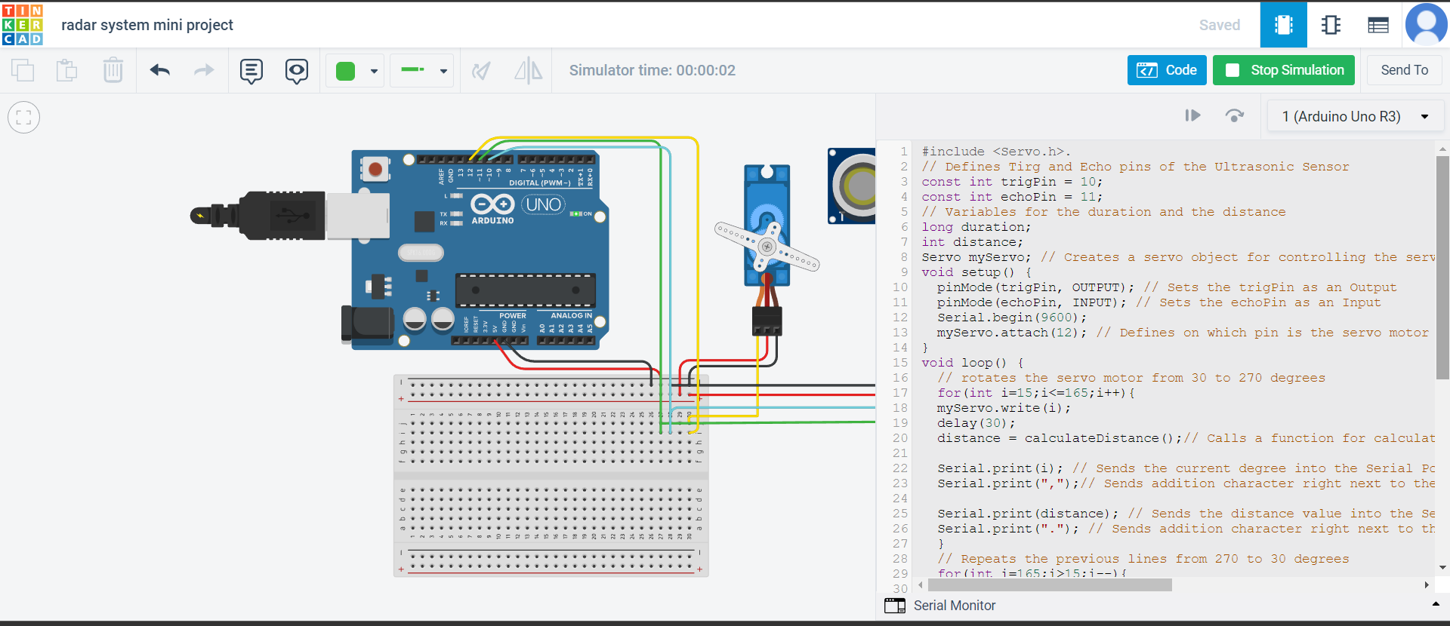

Slide 10
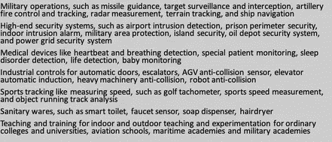
APPLICATIONS

Slide 11
THANK YOU

